Slide 1
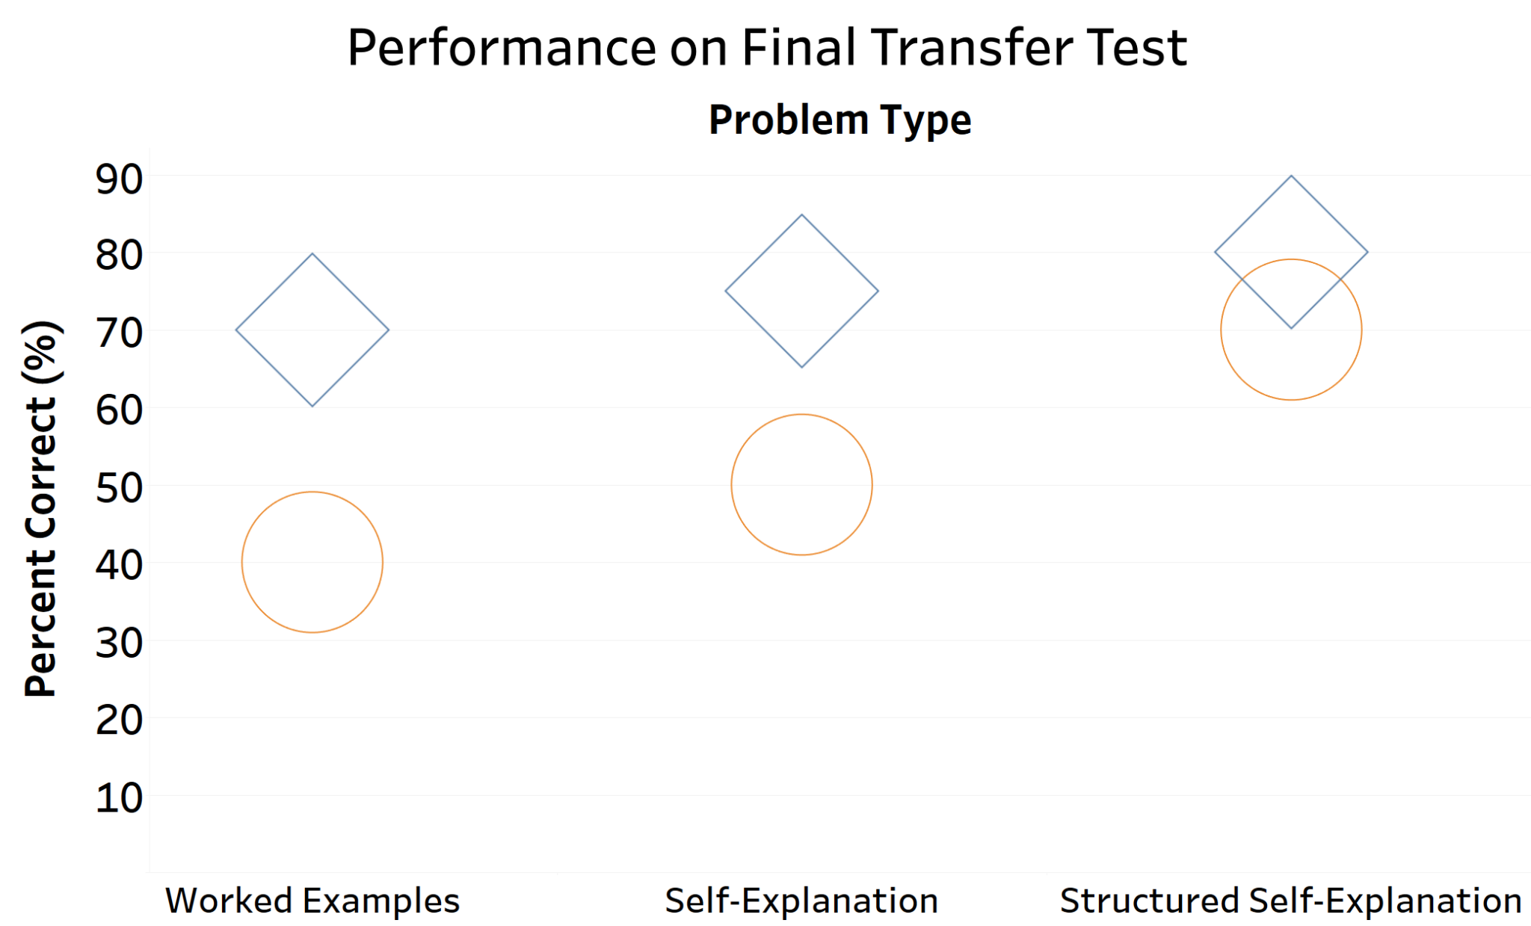
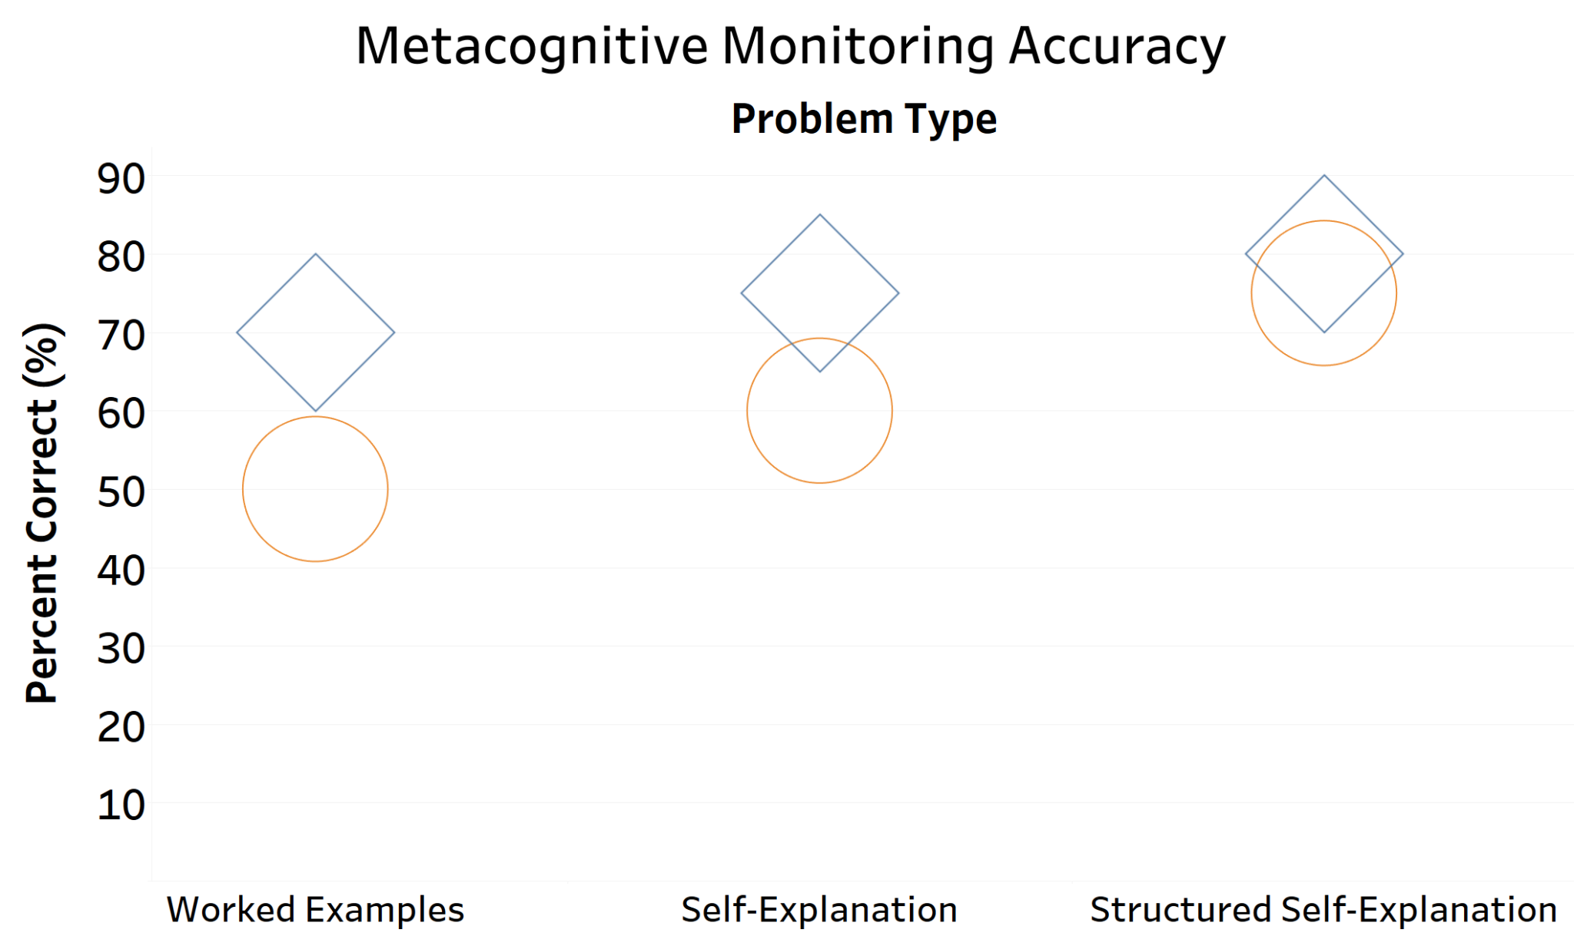
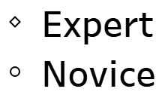
Lessening the gap: Worked examples, self-explanation, and metacognition across levels of expertise in math learning
Melanie Prieto & Dr. Hannah Hausman, University of California Santa Cruz
Contact: merpriet@ucsc.edu
How to improve Worked Examples (WE)
Procedure
Worked examples (WEs)–step-by-step solutions to a problem–are popular in classrooms and online (Chegg, PhotoMath, Slader) but are not universally beneficial for learning, transfer, and metacognition.
WEs are often used in conjunction with problem-solving practice (PS) and self-explanation (SE), which each involve their own strengths and limitations as learning techniques.
125 novices (UCSC undergraduates with no college-level statistics experience) and 125 experienced students (UCSC undergraduates who have taken 1 college-level statistics course with more experience but not mastery)
2 Videos: And/or & Conditional
You pick a card from a typical 52-deck set, and you know that it is black. What is the probability that it is a spade?
Global Judgment of Learning (JOL)
What percentage of problems do you think you could you answer correctly if you were to take a test on this material right now?
WE
WE + SE
WE + SSE
 | WE | PS | WE + PS | WE + SE
Access to accurate information | ✔ | ✖ | ✔ | ✔
Generation | ✖ | ✔ | ✔ | ✔
Attention directed to deep structural explanations | ✖ | ✖ | ✖ | ✖
Metacognitive accuracy³ | ✖ | ? | ✔ | ?
P(S|B) = P(S∩B) / P(B)
P(S∩B) = P(S) =
1/4
P(B) =
1/2
P(S|B) = P(S∩B) / P(B) =
(1/4) / (1/2) =
1/2
Explain why the problem was solved this way:
Why do we divide by P(B) and not P(S)?
12 Practice Problems
1 of 3 conditions
Why multiply and not add P(S) and P(B) to obtain P(S∩B)?
Global and By-Topic JOLs
What is the likelihood that you could correctly answer a problem like this on the final test?
Why does it make sense that the conditional probability with the two events (P(S|B)) is greater than the joint probability (P(S∩B))?
Poor metacognition → impaired self-regulation and learning²
Math self-efficacy
Do structured self-explanations improve metacognitive monitoring and learning?
Generation
Focus on surface
Generation
Broad instruction → focus on surface²
Novices conflate fluency with generation
Direction to structural features
Generation focused on structure
→ Expertise development (transfer)
Transfer Test Problems
20-problem Transfer Test
Practice Problem: A given problem about illnesses.
4 Types of Transfer Test Problems:
Expected Results
¹Chi, M. T. H., et al. (1989). Self-explanations: How students study and use examples in learning to solve problems. Cognitive Science, 13(2), 145-182,
²Hausman, H., Myers, S. J., & Rhodes, M. G. (2021). Improving metacognition in the classroom. Zeitschrift für Psychologie, 229(2), 89.
³Prieto, M., Hausman, H., Myers, S. J. & Rhodes, M. G. (2021, November). Worked Examples Impair Metacognitive Monitoring. Virtual poster presentation at the Harvard Women in Psychology Trends in Psychology Summit.
⁴Richey, J. & Nokes-Malach, T.. (2013). How much is too much? Learning and motivation effects of adding instructional explanations to worked examples. Learning and Instruction, 25, 104-124
 | Structurally similar | Structurally different
Superficially similar | Given problem about illness | And problem about illness
Superficially different | Given problem about machines in a factory | And problem about machines in a factory
References
Metacognitive monitoring accuracy: prediction test score - actual test score
Experts: Focus on conceptual structure & implicit features¹
Recognition of deep principles → internalize inference rules for transfer^{1,4}
Novices: Focus on surface or explicit features of problems
Experts outperform novices on problems that differ in their structural or superficial features⁴, as novices do not recognize the structural features critical for future transfer
How can we direct novices’ attention to structural features
Do novices in the SSE condition perform similar to experts in transfer?
WEs exacerbate the learning and metacognition gap between experts and novices
SEs encourage novices to activate prior knowledge, identify misconceptions, and generate arguments more than WE⁴
SSEs best reduces gaps: novice learners focus on deep principles, make connections to prior knowledge, generate information, and have their subjective experiences of difficulty reflect their actual understanding⁴

